Slide 1
7.5 Asian Options
指導老師：戴天時
演講者：鄭凱允

Slide 2
序
An Asian option is one whose payoff includes a time average of the underlying asset price.
The average may be over the entire time period between initiation and expiration or may be over some period of time that begins later than the initiation of the option and ends with the option’s expiration.

Slide 3
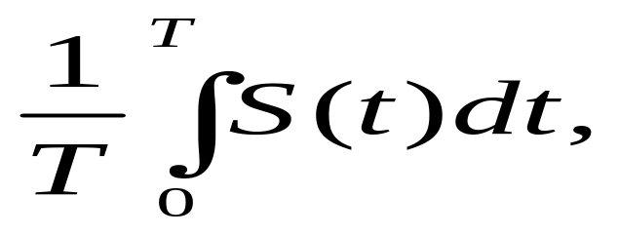
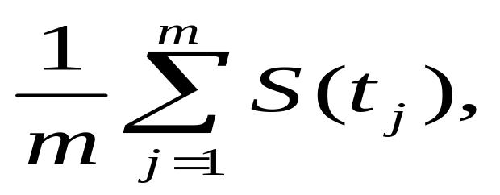
The average may be from continuous sampling,
Or may be form discrete sampling,
It more difficult for anyone to significantly affect the payoff by manipulation of the underlying asset price.
The price of Asian options is not known in closed form. Therefore, in this section we discuss two ways to derive partial differential equations for Asian option prices. The first of these was briefly presented in Example 6.6.1. The other method for computing Asian option prices is Monte Carlo simulation.

Slide 4
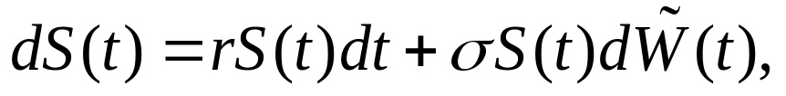




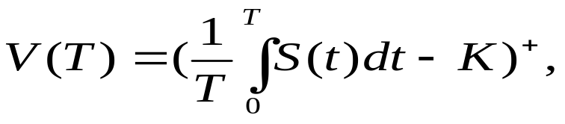

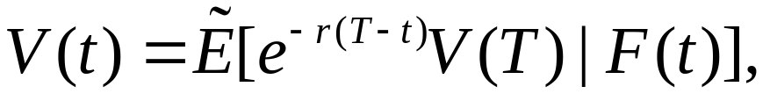


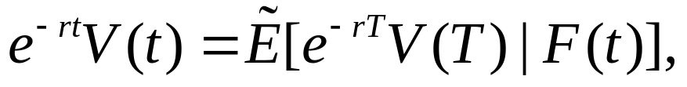

7.5.1 Fixed-Strike Asian Call
Once again, we begin with a geometric Brownian motion S(t) given by
where is a Brownian motion under the risk-neutral measure . Consider a Fixed-strike Asian call whose payoff at time T is
where the strike price K is a nonnegative constant. The price at times t prior to the expiration time T of this call is given by the risk-neutral pricing formula
The usual iterated conditioning argument shows
is a martingale under

Slide 5
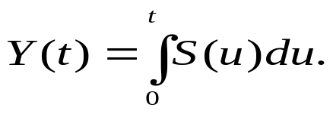



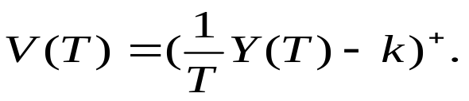

7.5.2 Augmentation of the State
The Asian option payoff V(T) in (7.5.2) is path-dependent. We cannot invoke the Markov property to claim that V(t) is a function of t and S(t) because V(T) is not a function of T and S(T); V(T) depends on the whole path of S.
To overcome this difficulty, we augment the state S(t) by defining a second process
Because the pair of processes (S(t),Y(t)) is governed by the pair of stochastic differential equations (7.5.1) and (7.5.5), they constitute a two-dimensional Markov process. Furthermore, the call payoff V(T) is a function of T and the final value (S(T),Y(T)) of this process. Indeed, V(T) depends only on T and Y(T), by the formula

Slide 6
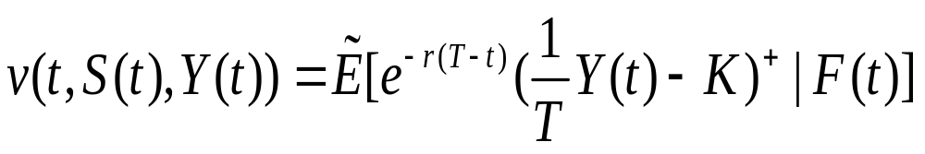
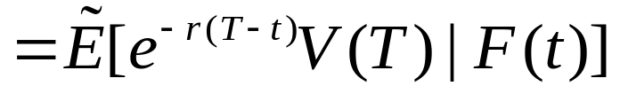

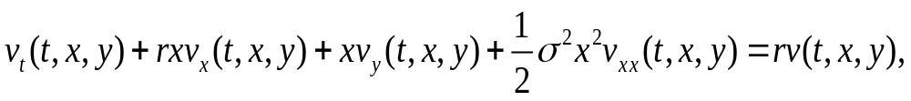


This implies that there must exist some function v(t,x,y) such that the Asian call price (7.5.3) is given as
Theorem 7.5.1
the Asian call price function v(t,x,y) of (7.5.7) satisfies the partial differential equation

Slide 7
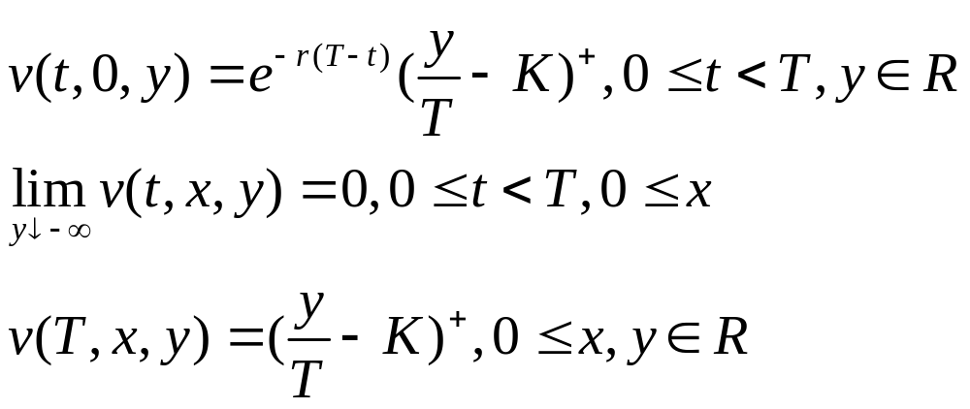





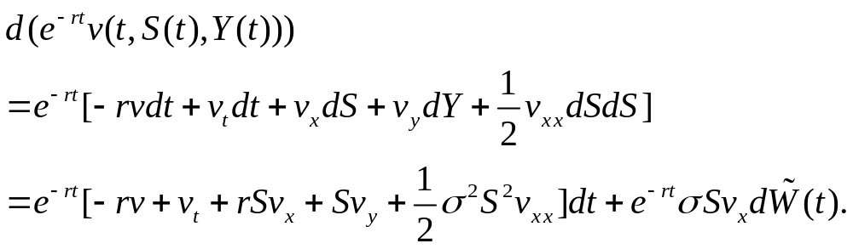

and the boundary conditions
Proof: Using the stochastic differential equations (7.5.1) and (7.5.5) and noting that dS(t)dY(t)= dY(t) dY(t)= 0 ,we take the differential of the -martingale This differential is

Slide 8
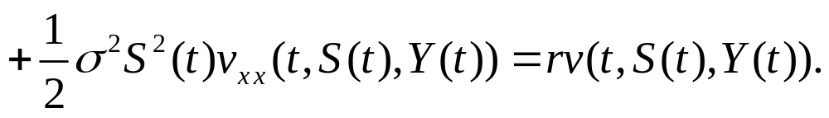



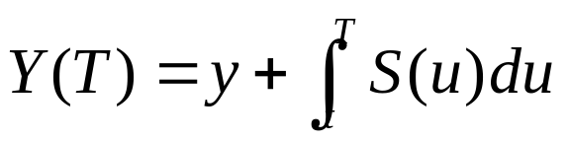

In order for this to be a martingale, the dt term must be zero, which implies
Replacing S(t) by the dummy variable x and Y(t) by the dummy variable y, we obtain (7.5.8)
We note that S(t) must always be nonnegative, and so (7.5.8) holds for
. If S(t)=0 and Y(t)=y for some value of t, then S(u)=0 for all
and so Y(u) is constant on [t,T]. Therefore, Y(T)=y, and the value of the Asian call at time t is , discounted from T back to t. this gives us the boundary condition (7.5.9).
If at time t we set Y(t)=y, then Y(T) is defined by (7.5.5). In integrated form, this formula is

Slide 9


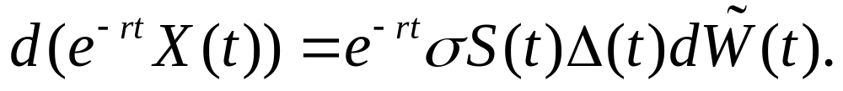

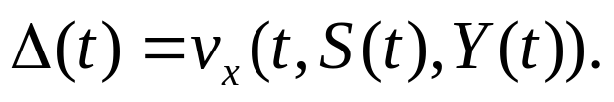
Remark 7.5.2
After we set the dt term in (7.5.12) equal to zero, we see that
The discounted value of a portfolio that at each time t holds shares of the underlying asset is given by (see (5.2.27))
To hedge a short position in the Asian call, an agent should equate these two differentials, which leads to the delta-hedging formula

Slide 10
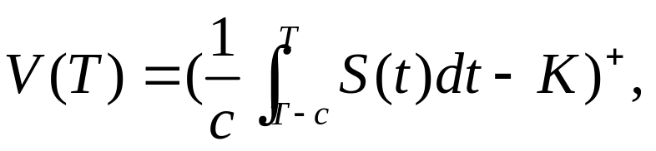


7.5.3 Change of Numeraire
In this subsection we present a partial differential equation whose solution leads to Asian option prices. We work this out for both continuous and discrete averaging. The derivation of this equation involves a change of numeraire, a concept discussed systematically in Chapter 9. in the section, we derive formulas under the assumption that the interest rate r is not zero. The case r=0 is treated in Exercise 7.8
We first consider the case of an Asian call with payoff
where c is a constant satisfying and K is a nonnegative constant. If c=T, this is the Asian call (7.5.2) considered in Subsection 7.5.2. Here we also admit the possibility that the averaging is over less than the full time between initiation and expiration of the call.

Slide 11
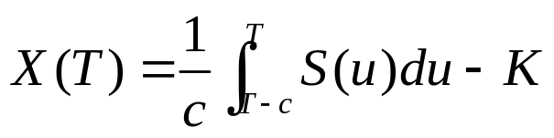




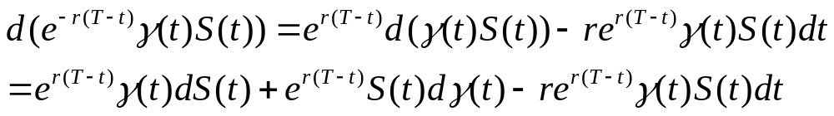


To price this call, we create a portfolio process whose value at time T is
We begin with a nonrandom function of time which will be the number of shares of the risky asset held by our portfolio. There will be no Brownian motion term in , and because of this it will satisfy
This implies that
which further implies
Rearranging terms in (7.5.18), we obtain

Slide 12


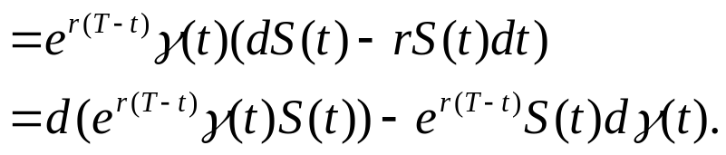


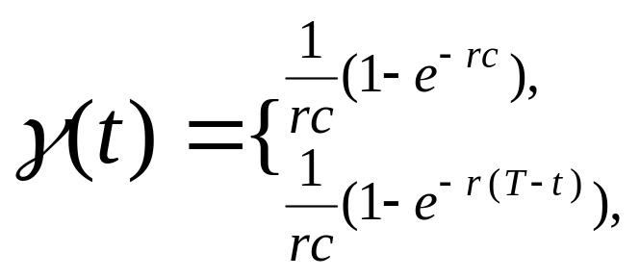
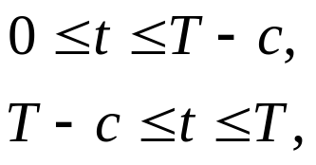

an agent who holds shares of the risky asset at each time t and finances his by investing or borrowing at the interest rate r will have a portfolio whose value evolves according to the equation
using this equation and (7.5.19), we obtain
To study the Asian call with payoff (7.5.16), we take to be

Slide 13
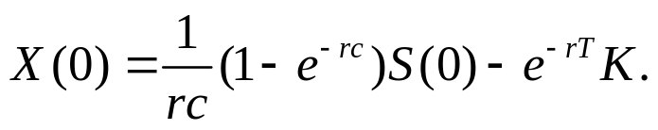








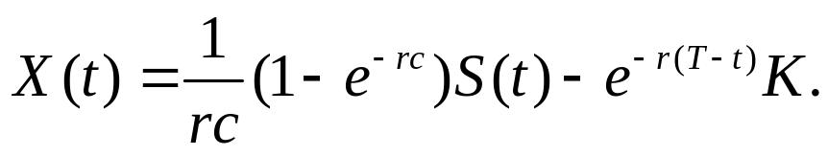

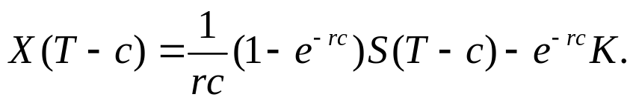

and we take the initial capital to be
In the time interval [0,T-c], the process mandates a buy-and-hold strategy. At time zero, we buy shares of the risky asset, which costs . Our in initial capital is insufficient to do this, and we must borrow from the money market account. For ,the value of our holdings in the risky asset is and we owe to the money market account. Therefore,
In particular,

Slide 14


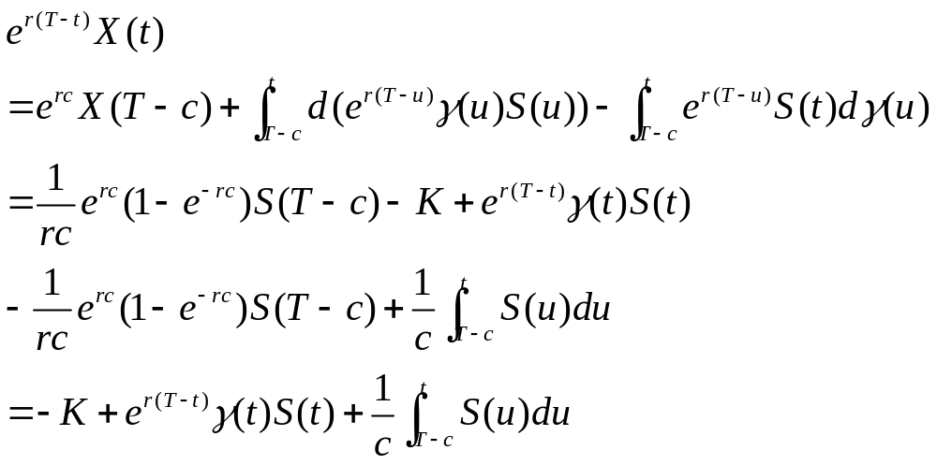
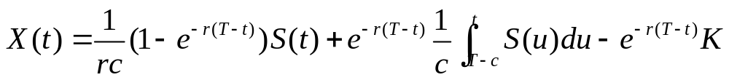


For we have and we compute X(t) by first integrating (7.5.21) form T-c to t and using (7.5.25) and (7.5.22) to obtain
therefore,

Slide 15
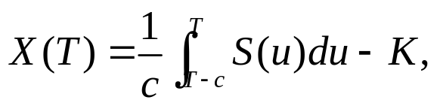




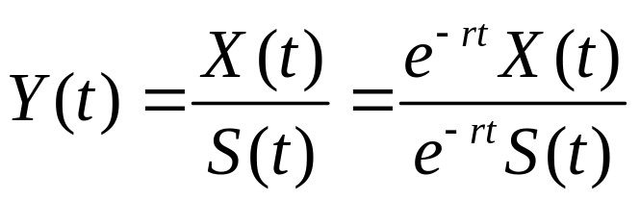
In particular,
As desired, and
The price of the Asian call at time t prior to expiration is
The calculation of the right-hand side of (7.5.29) uses a change-of-numeraire argument, which we now exlain. Let us define

Slide 16

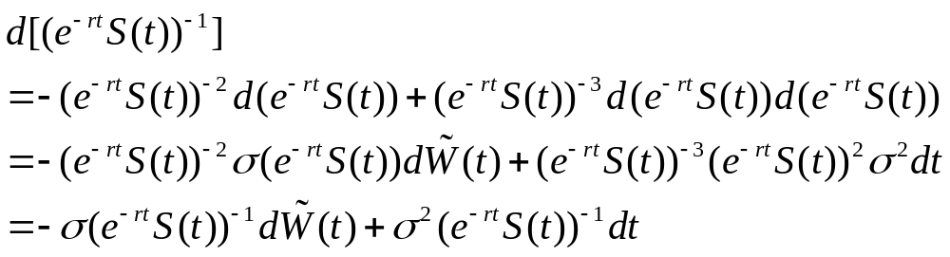
This is the value of the portfolio denominated in units of the risky asset rather than in dollars. We have changed the numeraire, the unit of account, from dollars to the risky asset.
we work out the differential of Y(t). Note first that
Therefore,

Slide 17
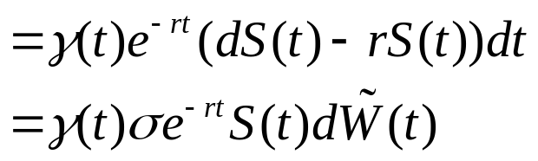



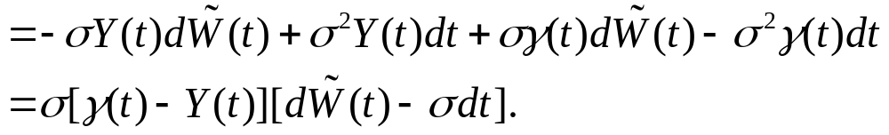

On the other hand, (7.5.20) and (7.5.30) imply
product rule implies

Slide 18
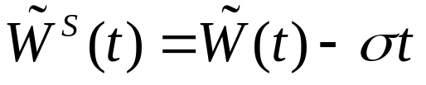








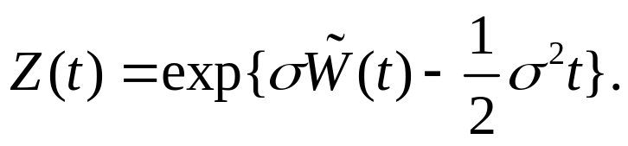
The process Y(t) is not a martingale under because its differential (7.5.31) has a dt term. However, we can change measure so that Y(t) is a martingale , and this will simplify (7.5.31). We set
And then have
According to Girsanov’s Theorem, Theorem 5.2.3, we can change the measure so that , ,is a Brownian motion. In this situation, plays the role of in Theorem 5.2.3, and and play the roles of W and P. the Radon-Nikodym derivative process of (5.2.11) is

Slide 19
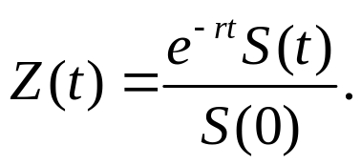


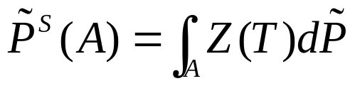



In other words,
Under the probability measure defined by
is a Brownian motion and Y(t) is a martingale.
Under the probability measure , the process Y(t) is Markov. It is given by the stochastic differential equation (7.5.33) is a function of t and Y(t) and has no source of randomness other than Y(t). Equation (7.5.33) is a stochastic differential equation of the type (6.2.1), and solutions to such equations are Markov (see Corollary 6.3.2).

Slide 20

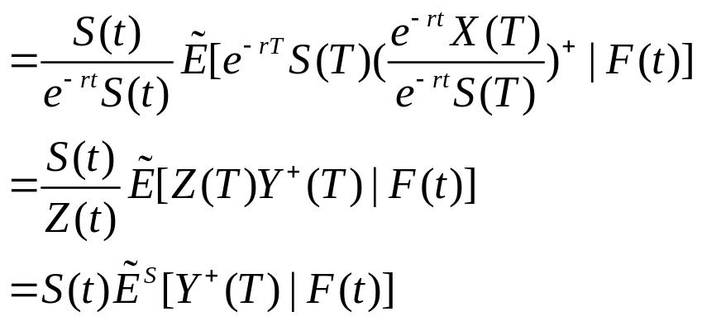



We return to the option price V(t) of (7.5.29) and use Lemma 5.2.2 to write (7.5.29) as
where denotes conditional expectation under the probability measure . Because Y is Markov under , there must be some function g(t,y) such that

Slide 21

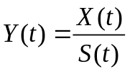




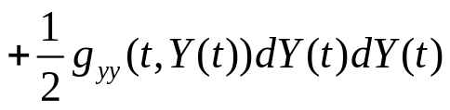
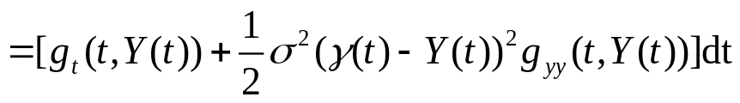

From (7.5.36), we see that
We note that can take any value since the numerator X(T), given by (7.5.27), can be either positive or negative , and the denominator S(T) can be any positive number. Therefore, (7.5.37) leads to the boundary condition
The usual iterated conditioning argument shows that the right-hand side of (7.5.36) is a martingale under , and so the differential of g(t,Y(t)) should gave only a term. This differential is

Slide 22
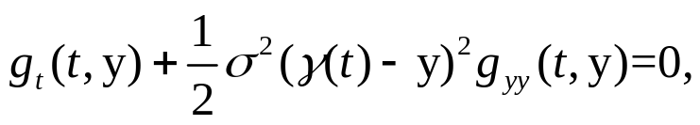




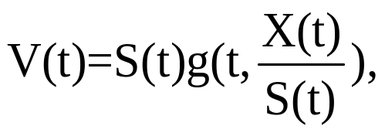

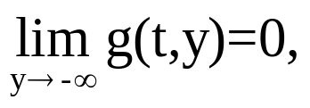
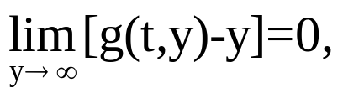

We conclude that g(t,y) satisfies the partial differential equation
Theorem 7.5.3 ( ).
For , the price V(t) at time t of the continuously averaged Asian call with payoff (7.5.16) at time T is
where g(t,y) satisfies (7.5.39) and X(t) is given by (7.5.24) and (7.5.26). The boundary conditions for g(t,y) are (7.5.38) and

Slide 23
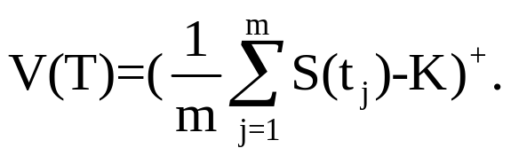

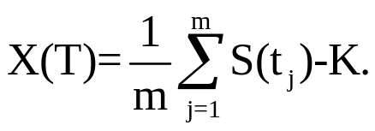
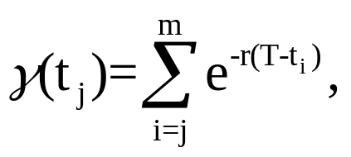


We adapt the arguments just given to treat a discretely sampled Asian call. Assume we are given times and the Asian call payoff is
We wish to create a portfolio process so that
In place of (7.5.22), we define

Slide 24
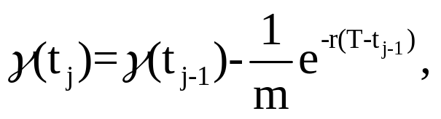


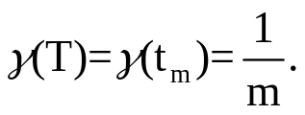












Then
and We complete the definition of by setting
This defines for all In this situation, (7,5,21) still holds, but now in each subinterval Integrating (7.5.21) from to and using (7.5.44) and the fact that for we obtain

Slide 25




Summing this equation from j=1 to j=k, we see that
We set
so this equation becomes

Slide 26







In particular,
as desired.
To determine X(t) for we integrate (7.5.21) from to t to obtain

Slide 27


Therefore,
  We now proceed with the change of numeraire as before. This leads again to Theorem 7.5.3 for the discretely sampled Asian call with payoff (7.5.42). The price at time t is given by (7.5.40), where g(t,x) satisfies (7,5,39) with boundary conditions (7.5.38) and (7.5.41). The only difference is that now the nonrandom function appearing in (7.5.39) is given by (7.5.43) and (7.5.45) and the process X(t) in (7.5.40) is given by (7.5.48).

Slide 28




5.2 Risk-Neutral Measure
5.2.1 Girsanov’s Theorem for a Single Brownian Motion
Thm1.6.1:probability space Z>0；E[Z]=1
We defined new probability measure
(5.2.1)
Any random variable X has two expectations:

Slide 29



5.2.1 Girsanov’s Theorem for a Single Brownian Motion
If P{Z>0}=1，then P and agree which sets have probability zero and (5.2.2) has the companion formula
  Z is the Radon-Nikody’m derivative of
  w.r.t. P, and we write

Slide 30
5.2.1 Girsanov’s Theorem for a Single Brownian Motion
Suppose further that Z is an almost surely positive random variable satisfying E[Z]=1, and we define by (5.2.1). We can then define the
We perform a similar change of measure in order to change mean, but this time for a whole process.

Slide 31



Lemma 5.2.1
Lemma 5.2.1. Let t satisfying be given and let Y be an -measurable random variable. Then
Proof:

Slide 32



Lemma 5.2.2
Lemma 5.2.2. Let s and t satisfying be given and let Y be an -measurable random variable. Then

Slide 33




Lemma 5.2.2
PROOF :
: measurable
We must check the partial-averaging property (Definition 2.3.1(ii)), which in this case is
the left hand side of(5.2.10)

Slide 34

5.2.1 Girsanov’s Theorem for a Single Brownian Motion ( Lemma 5.2.2)

Slide 35

Girsanov’s Theorem

Slide 36


5.2.1 Girsanov’s Theorem for a Single Brownian Motion( Girsanov, one dimension)
Using Levy’s Theorem : The process starts at zero at t=0 and is continuous.
Quadratic variation=t
It remain to show that is a martingale under

Slide 37


5.2.1 Girsanov’s Theorem for a Single Brownian Motion( Girsanov, one dimension)
Check Z(t) to change of measure.
We take
and Z(t)=exp{X(t)} ( f(X)=exp{X})
By Ito’s lemma( next page):

Slide 38

5.2.1 Girsanov’s Theorem for a Single Brownian Motion( Girsanov, one dimension)
no drift term>>martingale

Slide 39

5.2.1 Girsanov’s Theorem for a Single Brownian Motion( Girsanov, one dimension)
Integrating>>
Z(t) is Ito’ integral >>Z(t)~ martingale
So ,EZ=EZ(T)=Z(0)=1.
Z(t) is martingale and Z=Z(T),we have
Z(t) is a

Slide 40





5.2.1 Girsanov’s Theorem for a Single Brownian Motion( Girsanov, one dimension)
We next show that is martingale under P
is a martingale under

